Slide 1
RAJASTHAN HACKATHON 4.0
RAJHASTAN UNIVERSITY

Slide 2
TEAM: ECONAUTS COLLEGE- AIT pUNE
AMITAV SONI
ASHWANI PONIA
ARCHIT SHUKLA
KARAN DEEP SINGH BAJWA

Slide 3
PROBLEM STATEMENT
THEME: DATA WAREHOUSE
FOR MAINTAING PROPER WASTE DISPOSAL SYSTEM AT COMMUNITY wASTE DUSTBINS

Slide 4
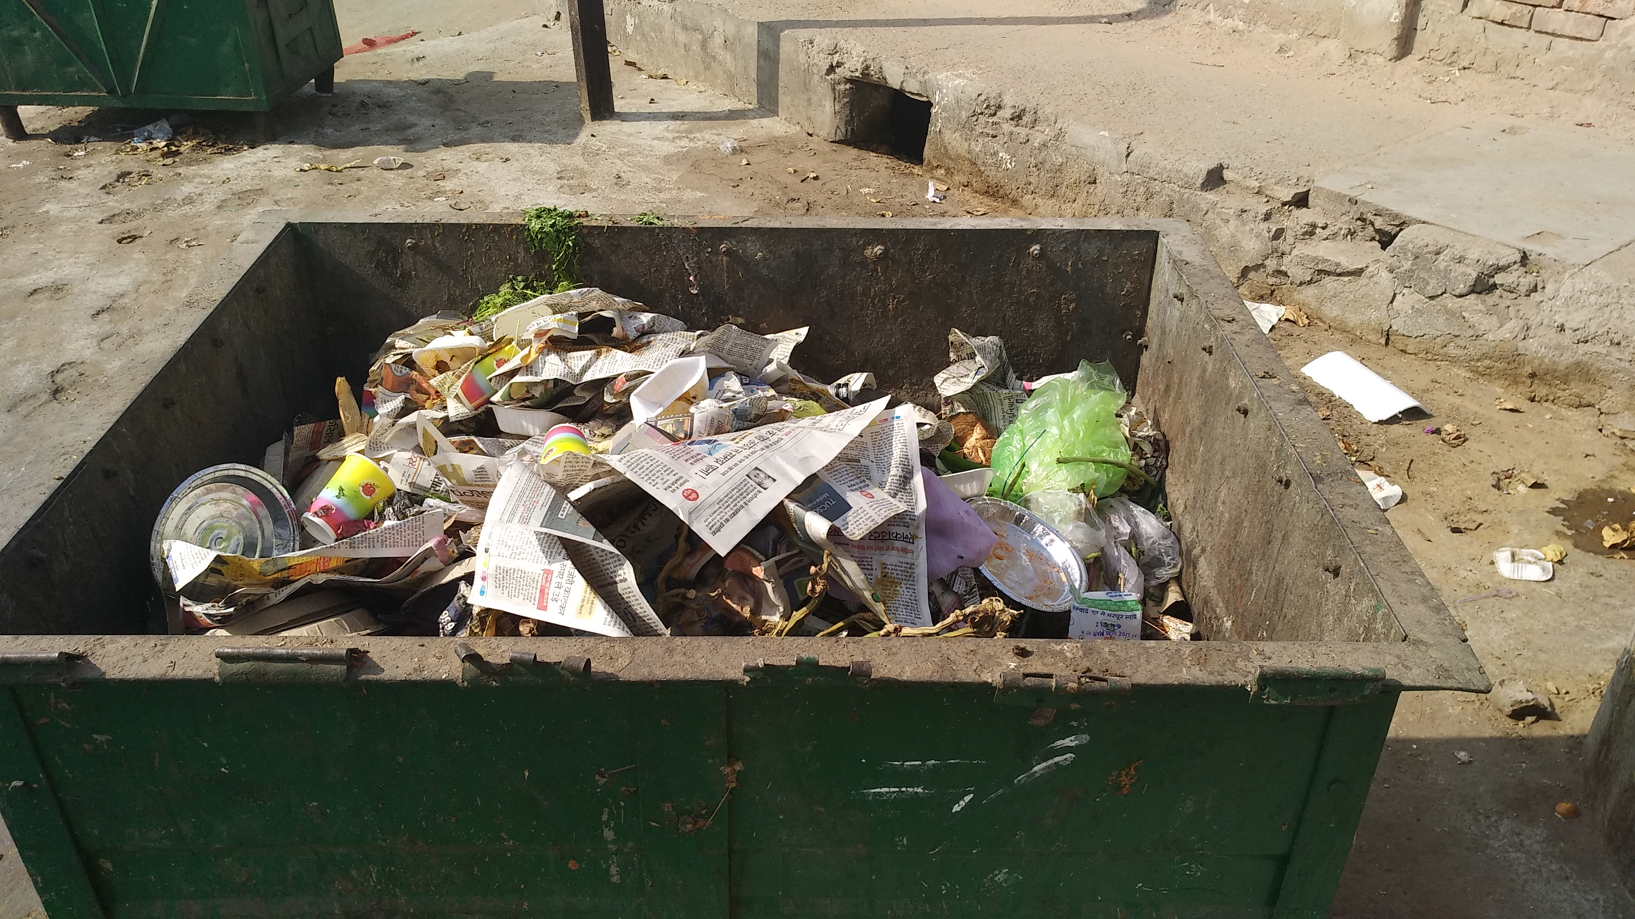
The Garbage problem
COMMUNITYWASTE DUSTBIN IN JAIPUR

Slide 5
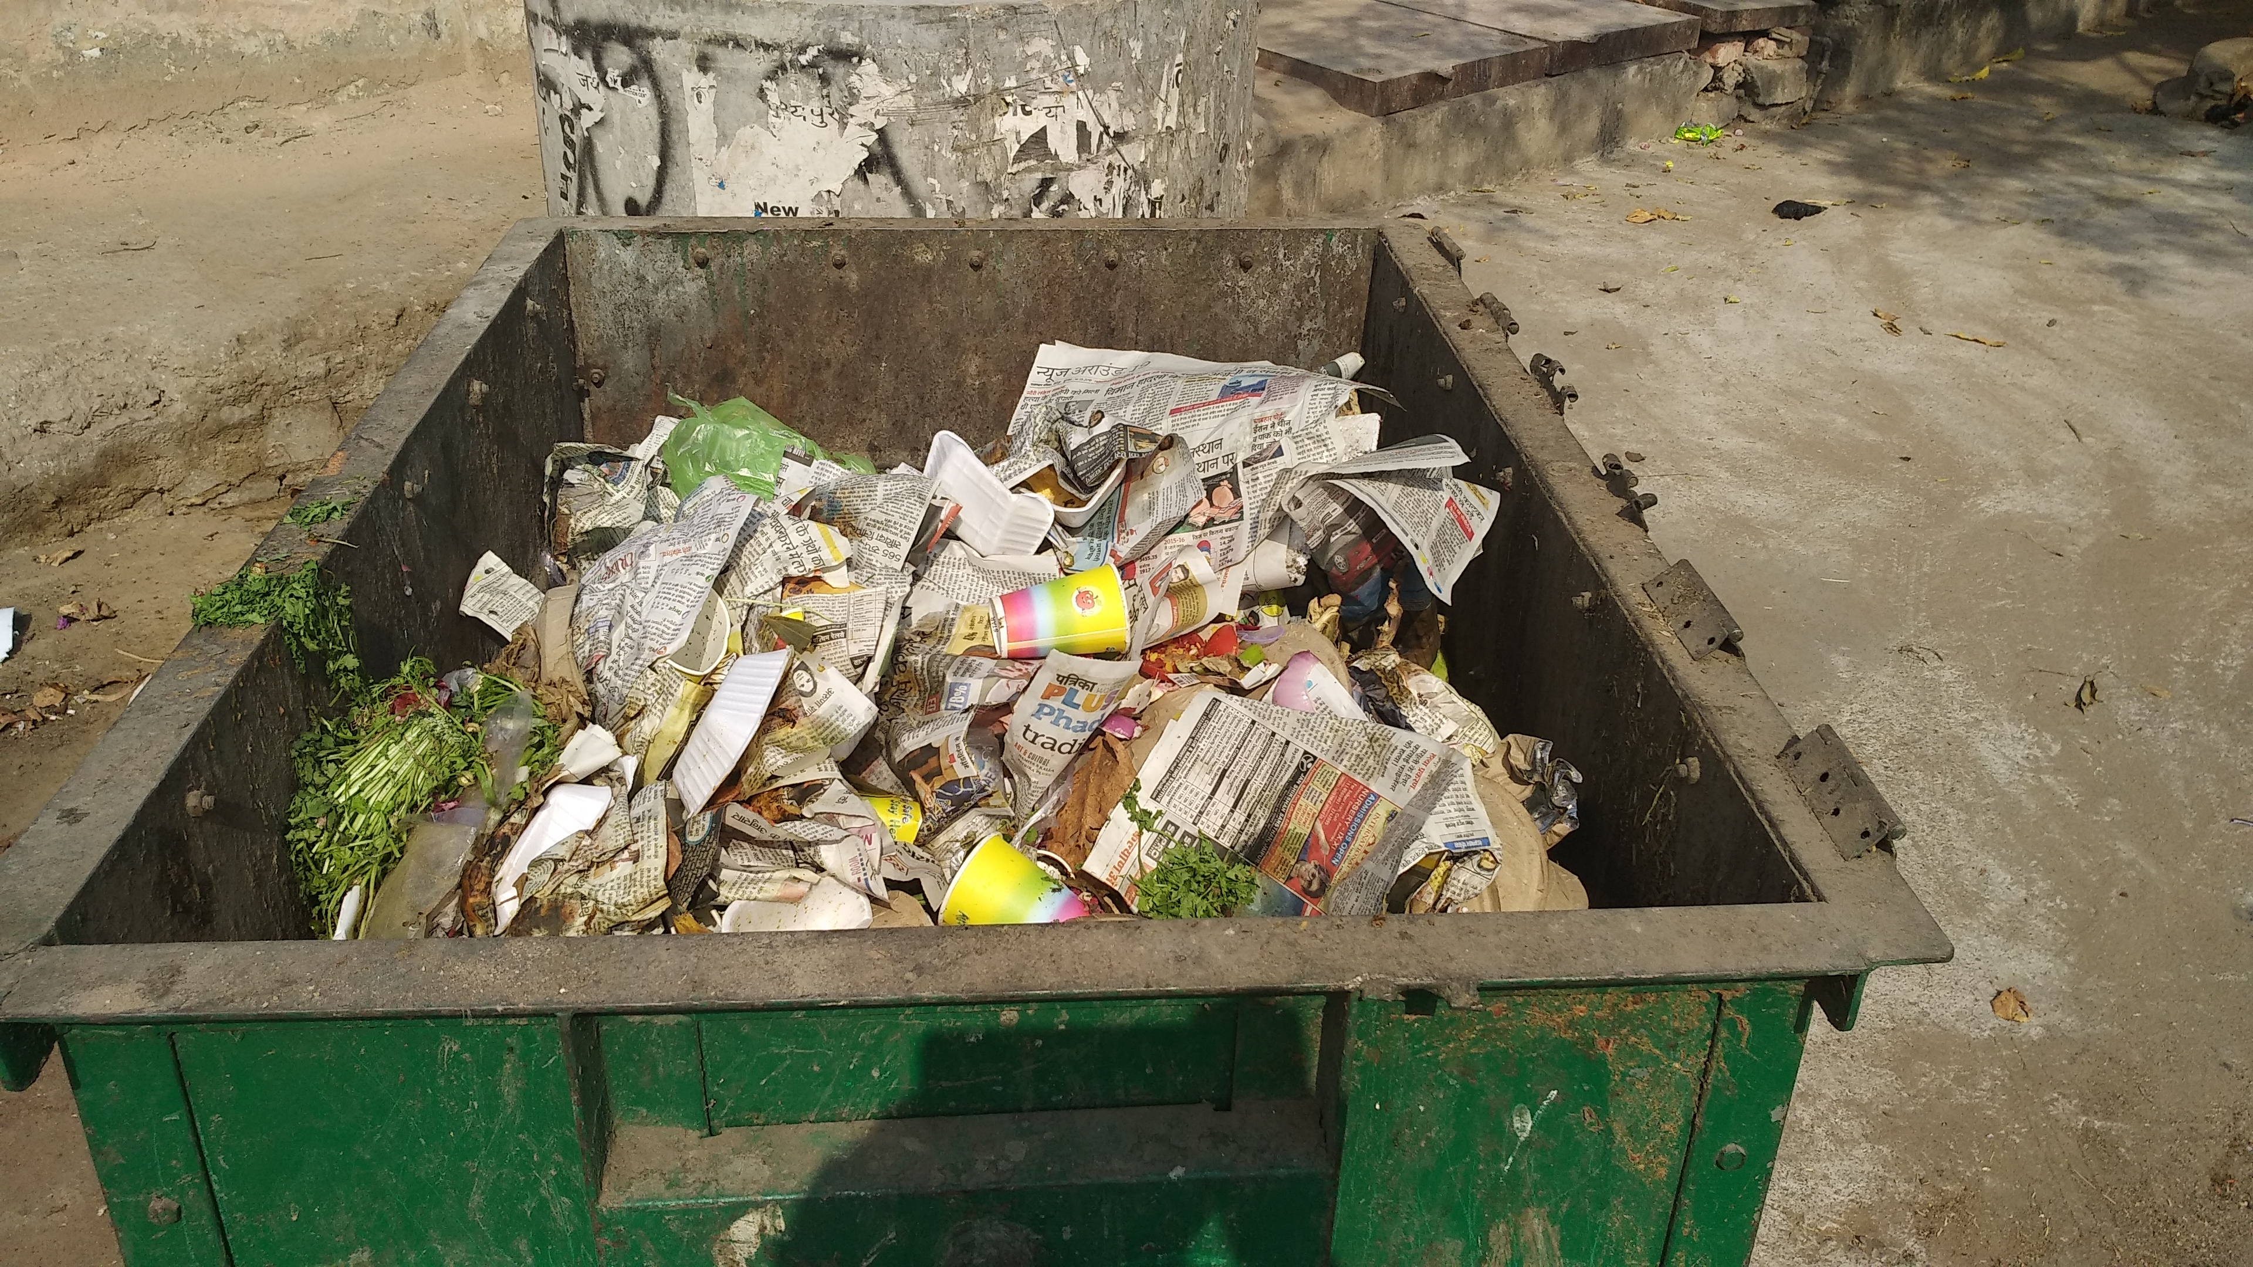
ANOTHER VIEW

Slide 6
CURRENT PROBLEM
DUSTBINS TODAY ARE LIDLESS, WHICH ALLOW THE SPREADING OF BAD ODOUR AND Infections. They also serve as feeding grounds for insects and stray animals.
There is no profound feedback system for the municipalities to analyse the dustbins. They are oblivious to dustbins which overflow everyday, localities which need more dustbins / frequent collection of garbage.

Slide 7
OUR SOLUTION
An intelligent-lid will be attached to the preexisting GARBAGE CONTAINERs. Containers will remotely connect with central receiver via (missed) phone call feedback.
Muncipalities will be provided with a website monitoring the dustbins in their jurisdiction. the Website will give real time information about the dustbins.
GIVEN SUFFICIENT TIME , THE WEBSITE WILL GATHER ENOUGH DATA TO HELP THE AUTHORITIES DETERMINE THE LOCALITIES WHICH WILL REQUIRE MORE GARBAGE CONTAINERS /FREQUENT COLLECTION OF GARBAGE .

Slide 8
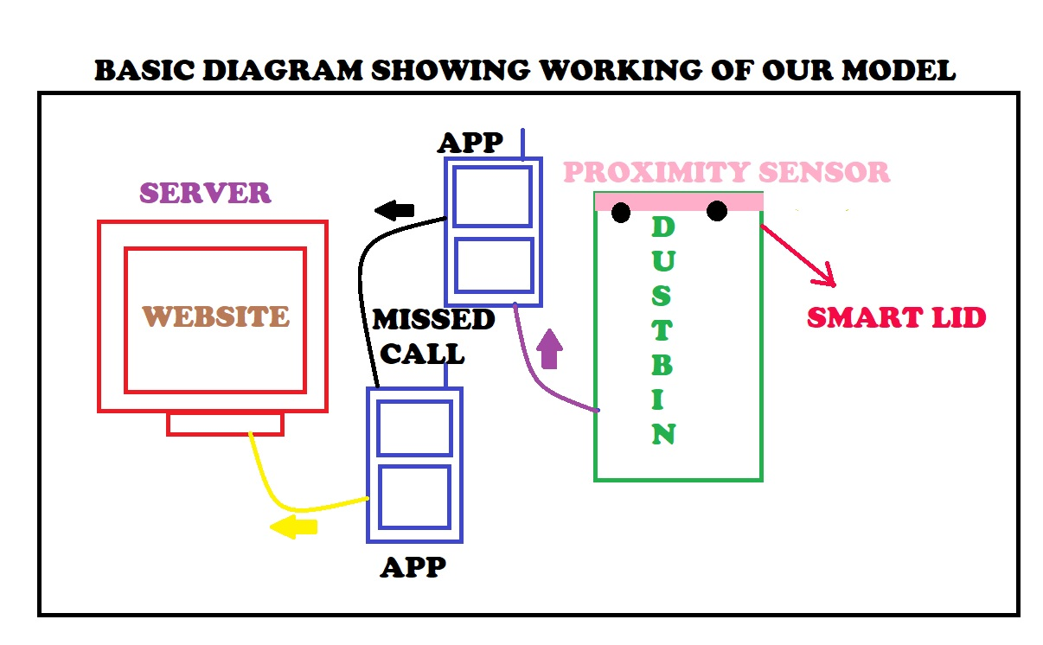

Slide 9
Working
A proximity sensor at the back of the smartlid will detect when the dustbin gets full and send a missed call to the central receiver to indicate the same. Another missed call will be sent to indicate when the dustbin is empty.
the central receiver will host a website to share the data with all the concerned municipalities. Data processing techniques will suggest appropriate actions like setting up more dustbins / increasing frequency of garbage collection.

Slide 10
Cost per lid
Components and approximate cost of components per lid :
Proximity sensor - ₹ 90
Lid metal : ₹ 150
Solar cell : ₹ 40
Microcontroller : ₹ 130
Transmitter: ₹70
Total estimated cost per lid : ₹ 480

Slide 11
practicality
Preexisting dustbins need not be discarded.
Solution is cost effective.
Can be implemented at a large scale.
Win-win for all.
Provides method to check on workers/municipalities.

Slide 12
Future prospects
Lids can be provided with compartments to allow segregation of data.
Localities with large volumes of waste can be provided with lids modified to include a waste compactor, increasing the amount of garbage that can be collected. (an estimate three fold increase in waste carrying capacity.

Slide 13


